Slide 1
OCR +LLM Based Data extraction from documents
Machine Learning [3CS101CC24]
By: Deep Joshi [24BCE152]

Slide 2


Core concept
Automated document processing systems in finance and logistics frequently use Optical Character Recognition (OCR) combined with Large Language Models (LLMs) to convert unstructured invoices and receipts into structured database rows. However, generative vision-language models frequently hallucinate values, transpose digits, misalign line items, or miss discounts, without providing calibrated confidence estimates. In enterprise accounting, accepting an unverified hallucination causes tax non-compliance, ledger imbalances, and financial audit penalties.

Slide 3
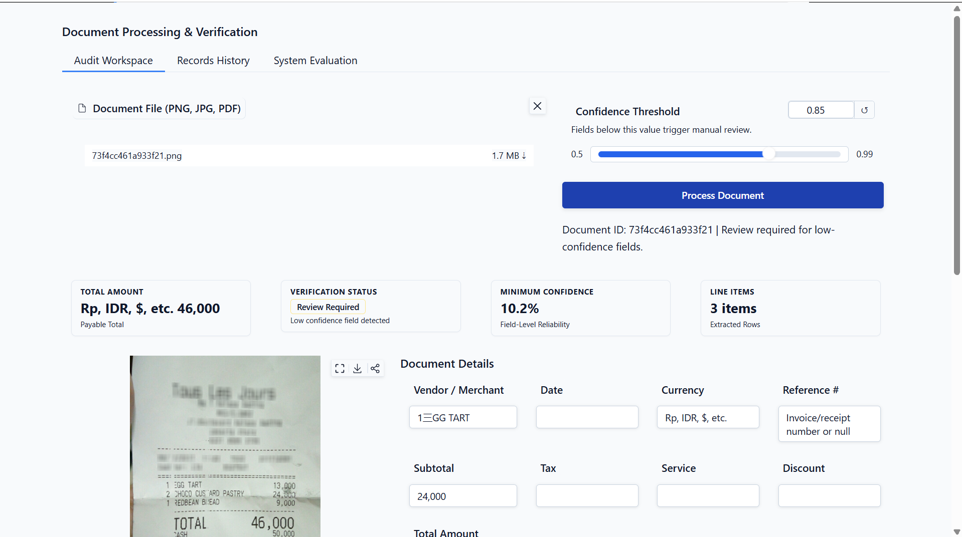
The Document Processing Platform
Upload the Image (PNG/JPG) or Document (PDF)
OCR Based extraction using Docling+RapidOCR
The extracted content is formatted using Gemma 3n:2b in JSON format
Verify the generated JSON with the text extracted for approval
Uses Histogram Gradient Boosting for approval/review
Store data in Parquet form

Slide 4
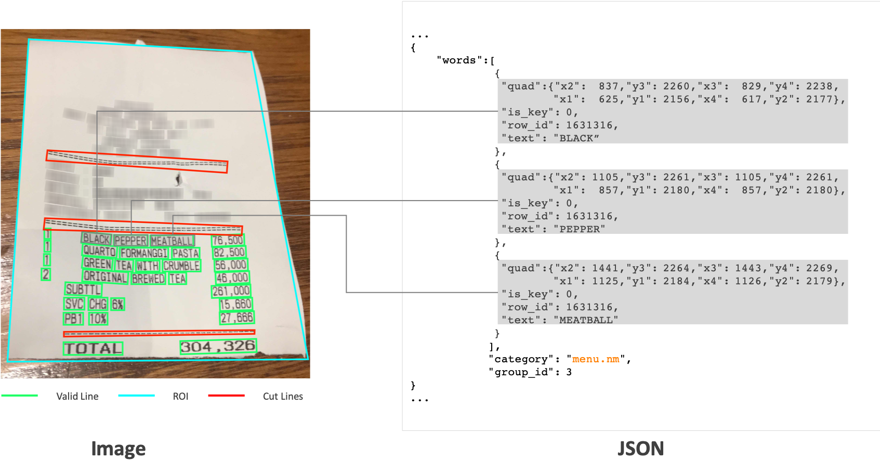
The Dataset: CloveAI’s CORD DATASET

Slide 5
DaTA Processing
Access data from: naver-clova-ix/cord-v2 on HuggingFace
Clean strings, bring numericals to Indonesian Decimal using parser.
Reduced duplicates using Optimal Bipartite Hungarian Matching for text matching scores between OCR extraction and generated JSON to rectify hallucination from Small Language Models like Gemma 3n:2b.
Checking EXIF of uploaded image for orientation correction, Caching using SHA-256 for reuploaded images for faster processing to showcase output from existing data from Parquet.

Slide 6

Model Architecture:
DOCLING+RAPIDOCR
Docling simplifies document processing by parsing diverse formats — including advanced PDF understanding — and providing seamless integrations with the generative AI ecosystem.
RapidOCR is a completely open-source, free OCR tool that supports multi-platform, multi-language operation and rapid offline deployment. Its core advantages lie in extreme speed and extensive compatibility.

Slide 7

MODEL ArchITECTURE:Gemma 3n:E2B
Gemma 3n models use selective parameter activation technology to reduce resource requirements. This technique allows the models to operate at an effective size of 2B and 4B parameters, which is lower than the total number of parameters they contain.

Slide 8
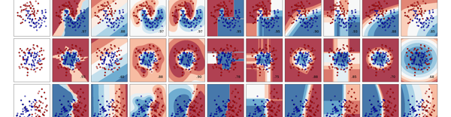
MODEL ArchITECTURE:Gemma 3n:E2B
Histogram-based Gradient Boosting (HistGradientBoosting) is an optimized implementation of the Gradient Boosted Decision Trees (GBDT) machine learning algorithm.

Slide 9
Validation and Evaluation
Evaluated strictly once on unseen test split.
Test PR-AUC: 0.9212
ROC-AUC: 0.9782
Balanced Accuracy: 95.77%
Brier Score: 0.0045.
1,000-resample receipt cluster bootstrap 95% CIs. Risk-Coverage selective classification analysis.

Slide 10
THANK YOU!

